Slide 1

CAPSTONE PROJECT
STOCK PRICE
PREDICTION SYSTEM
TEAM H
Donghun Jung
Chanyoung Lee
Yujin Seo

Slide 2
Contents
01
02
03
04
05
Project
Objectives
AI Models
& Programs
Challenges
& Progress
Result
& Discussion
Demo

Slide 3
Project Objectives
Stock Price Prediction System
Using AI Models – LSTM, GRU, Transformer
Specialized for sequential data(time series data) analysis
Front-end Implementation
Visualize real and predictive graphs through website development
Not Real-Time

Slide 4

Project Objectives
What is the difference with existing services?
There are already many stock investment services using AI
But they care about the stable distribution and management of assets of the users

Slide 5
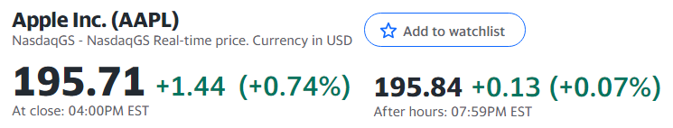
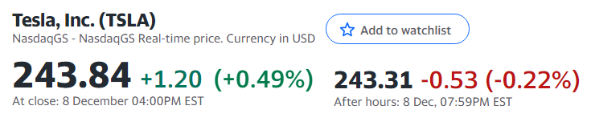
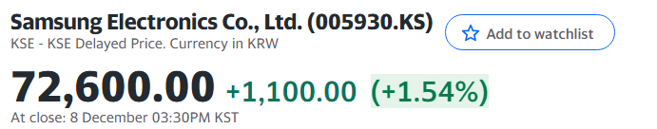
Project Objectives
So, we decided to focus only on improving the predictive performance…
Because it is hard to implement many functions due to the limited cost and time given

Slide 6
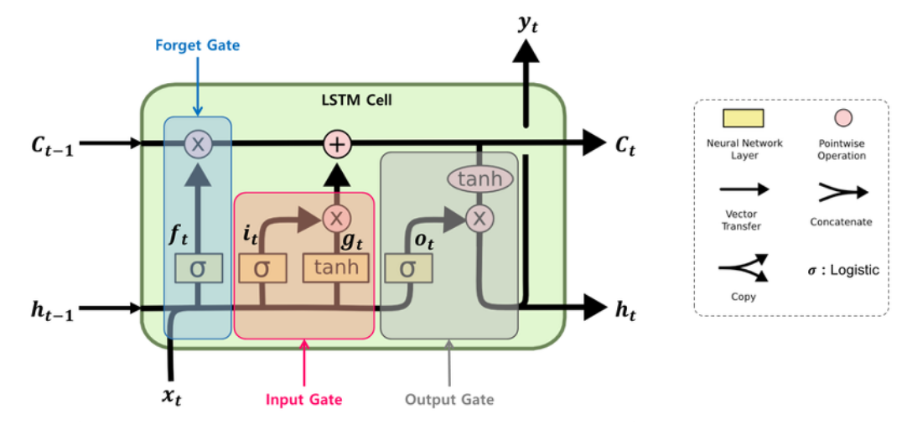
AI Models & Programs
LSTM (Long Short Term Memory)
Solves gradient vanishing problem of existing RNN when input data is too long

Slide 7
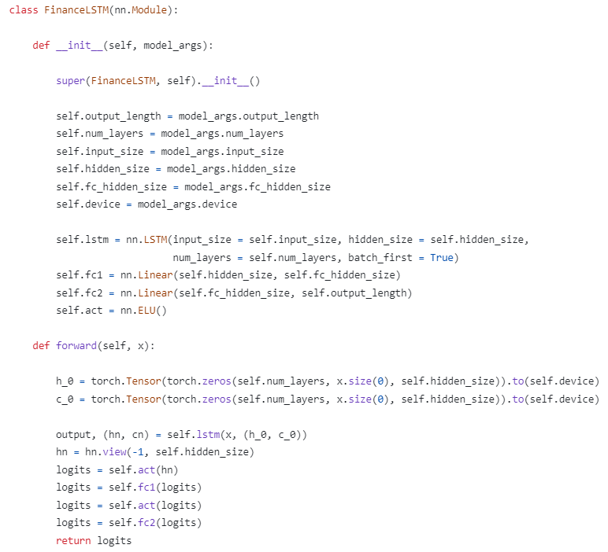
AI Models & Programs
LSTM (Long Short Term Memory)
Solves gradient vanishing problem of existing RNN when input data is too long

Slide 8
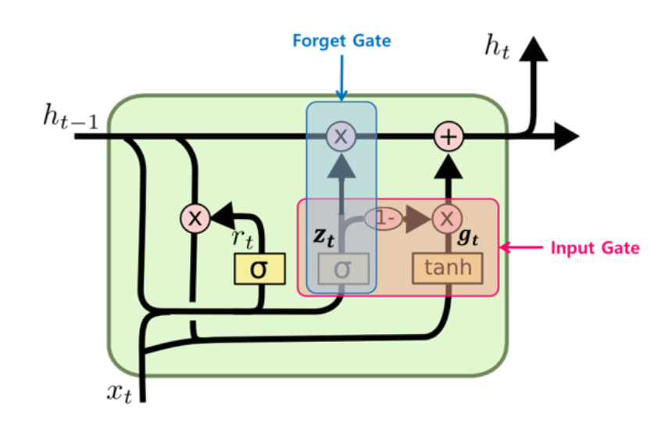
AI Models & Programs
GRU (Gated Recurrent Unit)
A version of simplifying the time-step cell that makes up the LSTM

Slide 9
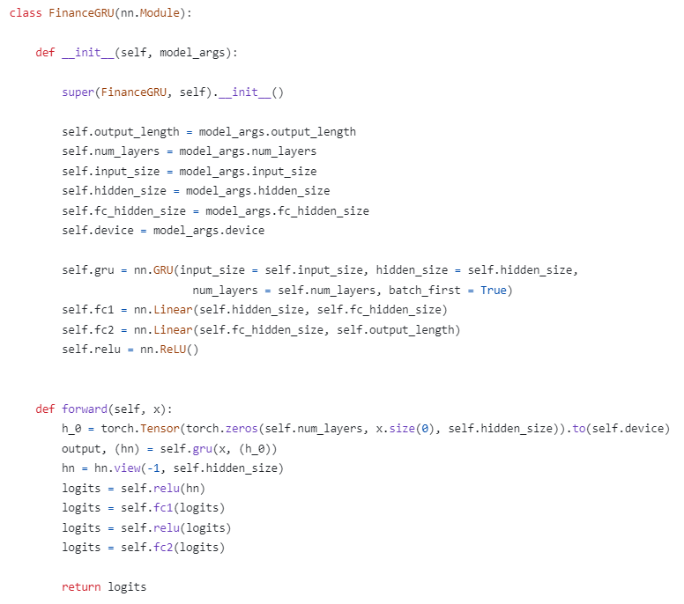
AI Models & Programs
GRU (Gated Recurrent Unit)
A version of simplifying the time-step cell that makes up the LSTM

Slide 10

AI Models & Programs
Transformer
Parallel processing is possible by putting the sequence at once, and location information can be reflected

Slide 11
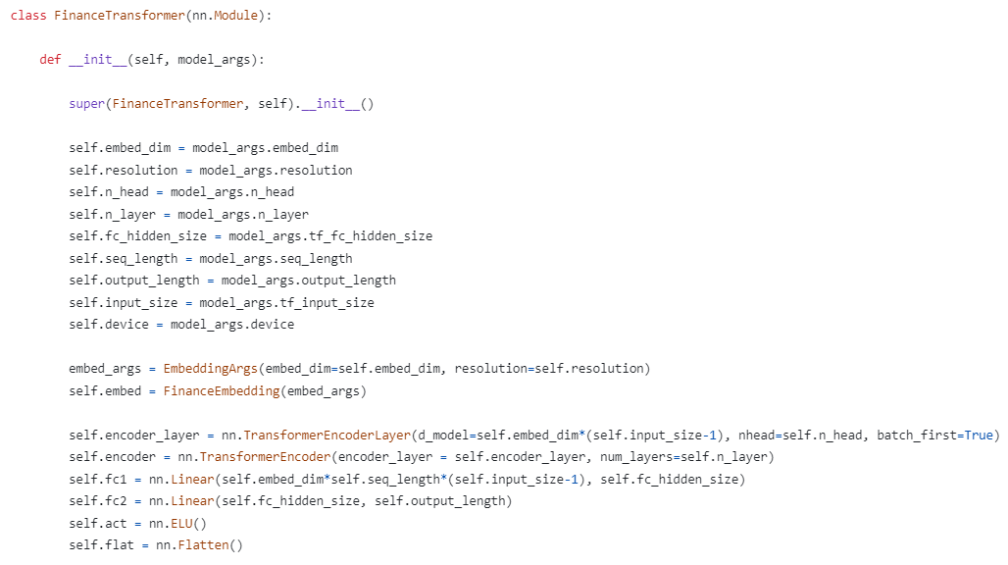
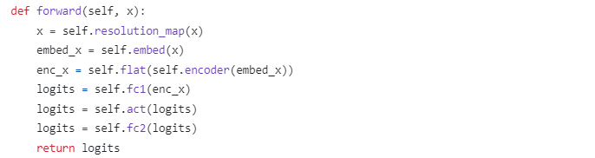
AI Models & Programs
Transformer
Parallel processing is possible by putting the sequence at once, and location information can be reflected

Slide 12



AI Models & Programs
Backend Programs

Slide 13

AI Models & Programs
Frontend Programs

Slide 14
Challenges & Progress
Graph Shifting
: “Tomorrow’s stock price will be Today’s stock price”

Slide 15
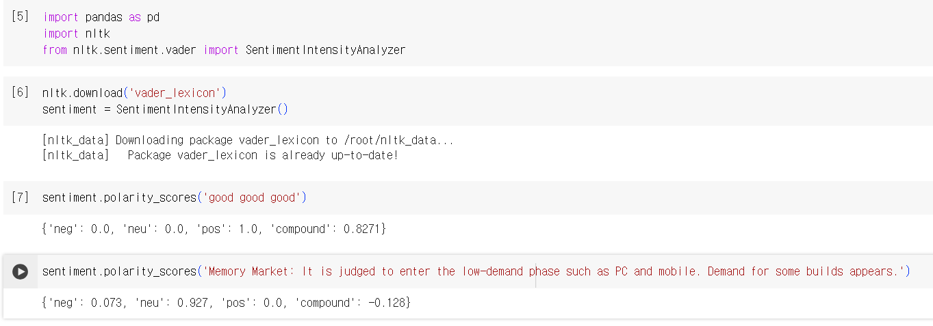
Challenges & Progress
Problem: Graph Shifting
💡 Solution: Apply more diverse figures to predictions
👉 Progress: Apply VADER score of stock market articles

Slide 16
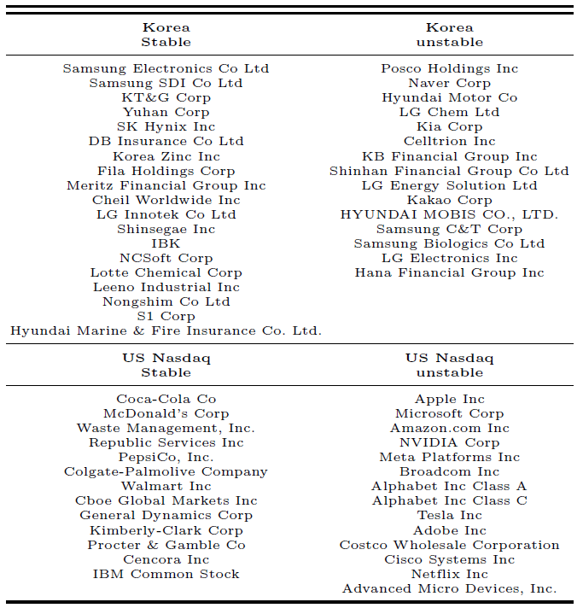
Challenges & Progress
Problem: Graph Shifting
💡 Solution: Train models with another stock data
👉 Progress: Increase the dataset and divide it into 4 categories

Slide 17
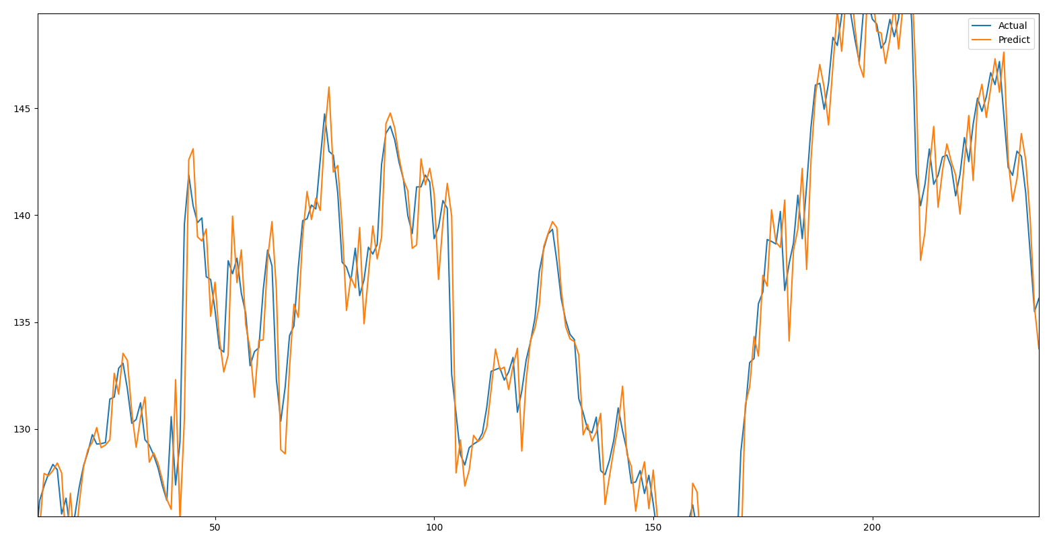
Challenges & Progress
Problem: Graph Shifting
💡 Solution: Make some changes in the learning rate of the models
👉 Progress: Apply learning rate scheduler to prediction system

Slide 18
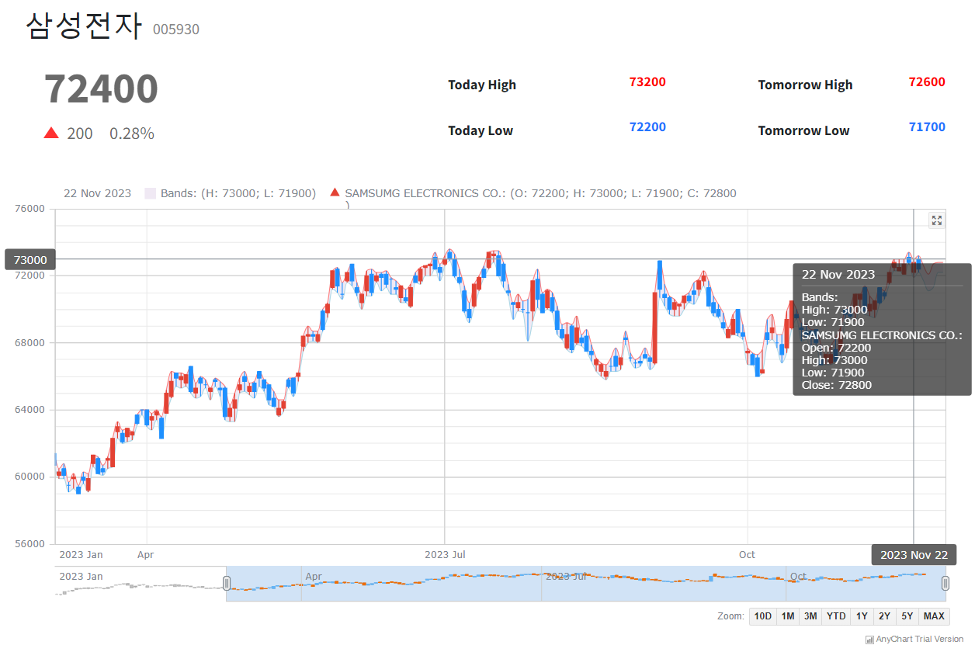
Demo
Stock Name
Stock Price (Real)

Slide 19
Demo
Today Stock Price (Prediction)
Tomorrow Stock Price (Prediction)

Slide 20
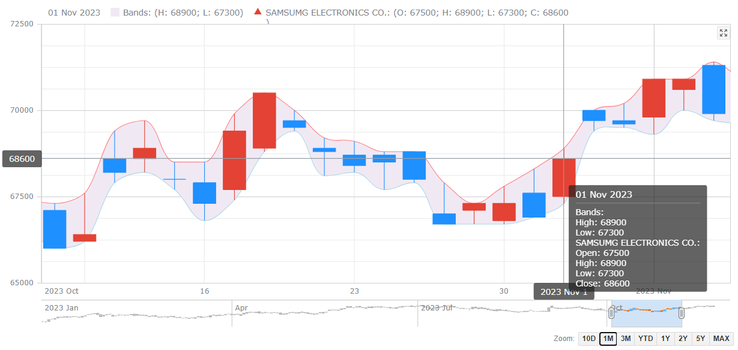
Demo
Stock price visualization: up & down
Prediction range: high - low
Stock prediction information
for each date

Slide 21
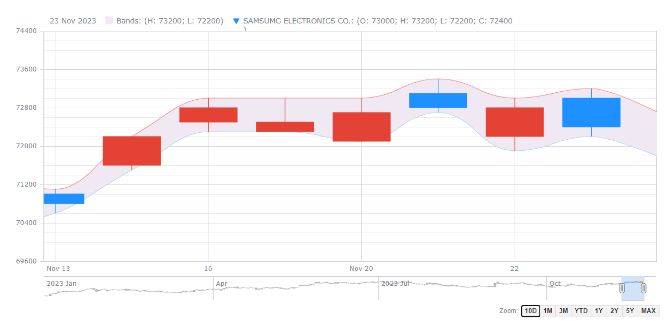
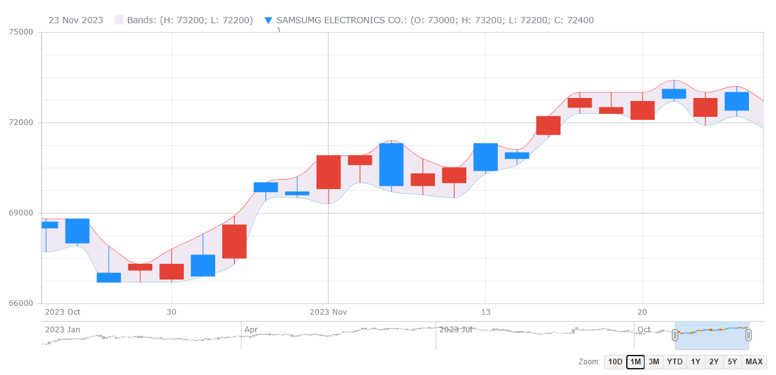
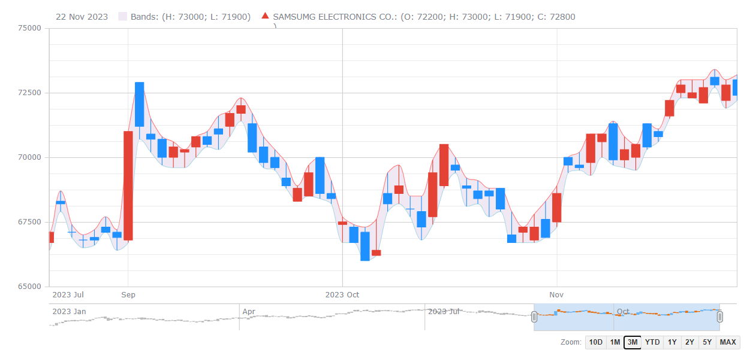
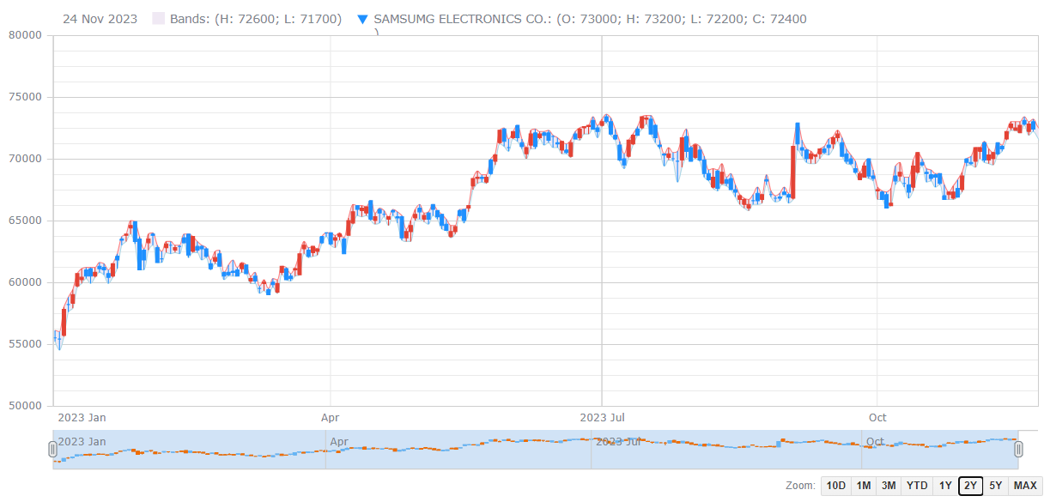
Demo
Period: 10 days
Period: 1 month
User can select the period with buttons or time scrollbar
Period: 3 months
Period: 2 years

Slide 22
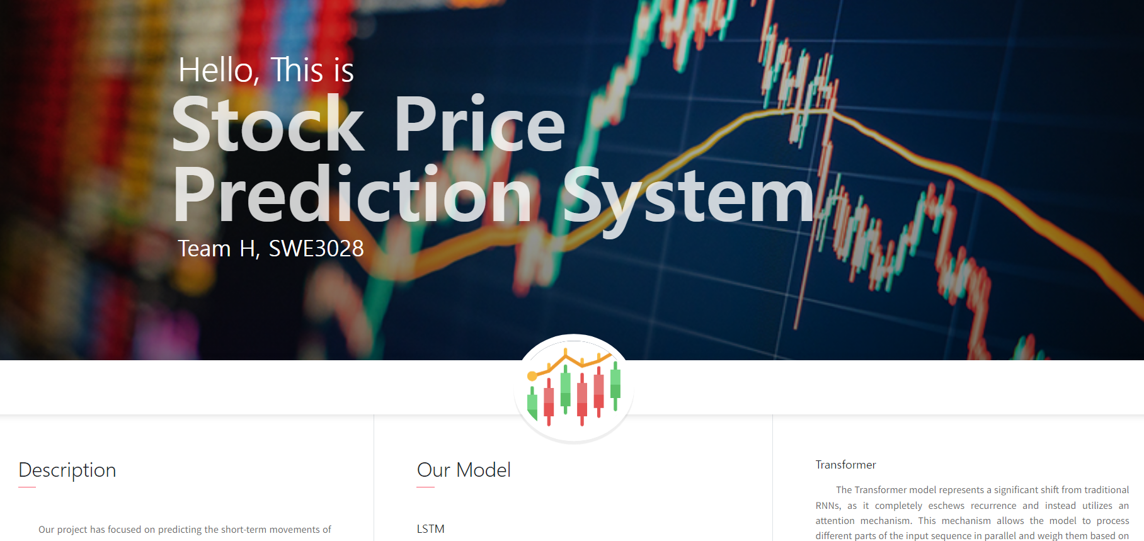
Demo

Slide 23
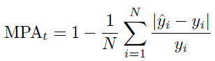
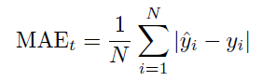
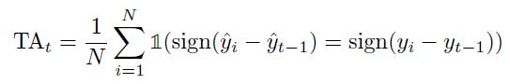
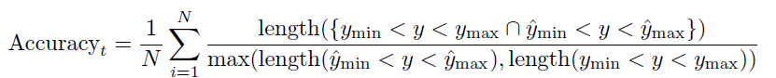
Result & Discussion
Accuracy measurement method
MPA & MAE: Evaluate the effectiveness of our methods
TAC: Focus on short-term stock price trends
Accuracy: Compare the similarity between the predicted and actual price intervals

Slide 24
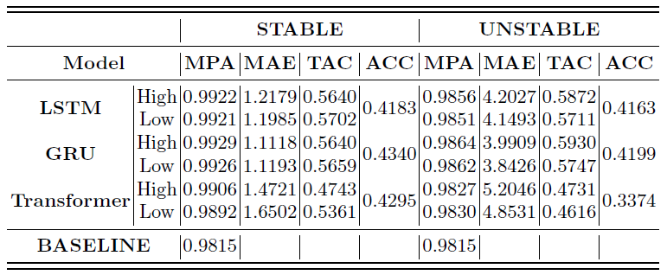
Result & Discussion
Performance of our models on the test set is quantified.

Slide 25
Result & Discussion
Incorporating VADER has resulted in MPA surpassing that of the baseline model (DP-LSTM).
It seems that applying VADER score has the effect of increasing prediction accuracy.

Slide 26
Result & Discussion
The model’s performance varies based on the stability of the stocks. For unstable stocks, the MAE significantly increases, and ACC decreases.

Slide 27
Result & Discussion
Both LSTM and GRU models exhibit similar performance metrics, whereas the Transformer model has relatively lower performance.

Slide 28
Result & Discussion
Limitations: Prediction Quality
Increased inaccuracies for specific cases
Problem arises when the stock price remains relatively constant with minor fluctuations (2023-11-16 to 2023-12-01)

Slide 29
Result & Discussion
Limitations: Lack of Information
Imbalance of news articles
Famous stocks have a lot of related information, but obscure stocks update less and slower
Articles written in a limited period of time
The referenced news site's articles are limited to maximum 1,000 per stocks

Slide 30
Roles
Donghun Jung
Creating the initial UI/UX design
Chanyoung Lee
Implementing GRU, CNN, Transformer
Yujin Seo
Implementing GRU and collecting news information

Slide 31

Any Question?

